Slide 1
PUC AIRLINES

Slide 2
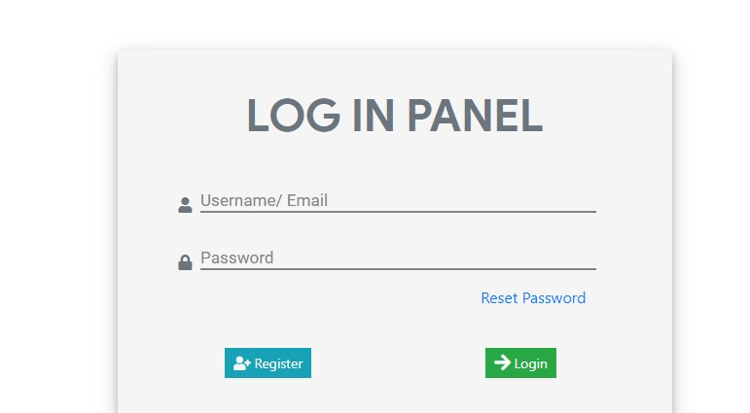
Login for users

Slide 3
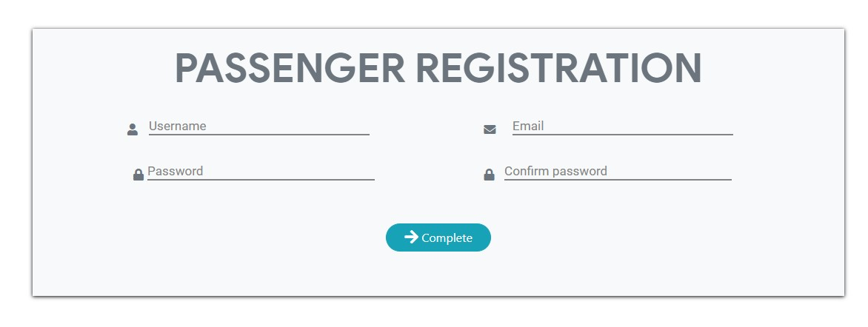
Signup for users

Slide 4
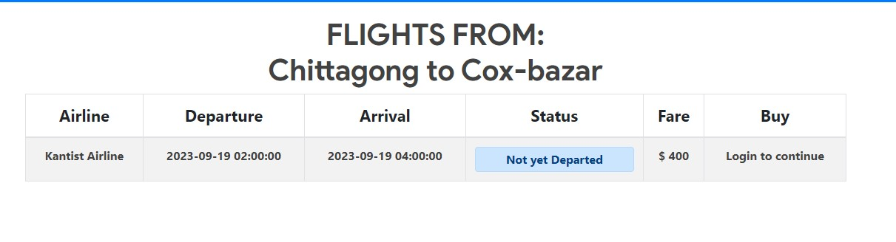
Ticket search

Slide 5
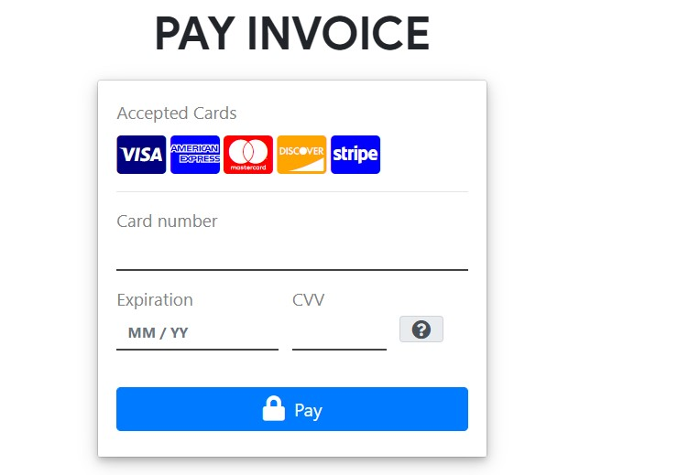
Payment for Ticket

Slide 6
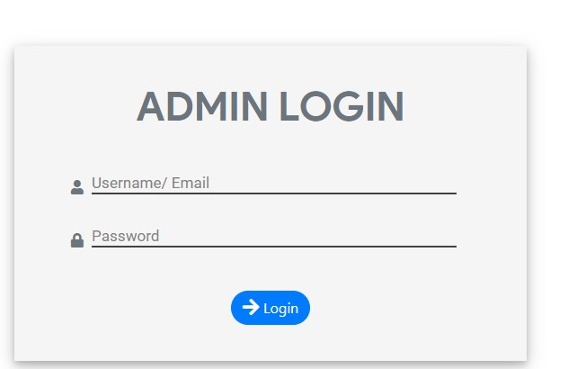
Admin Login

Slide 7
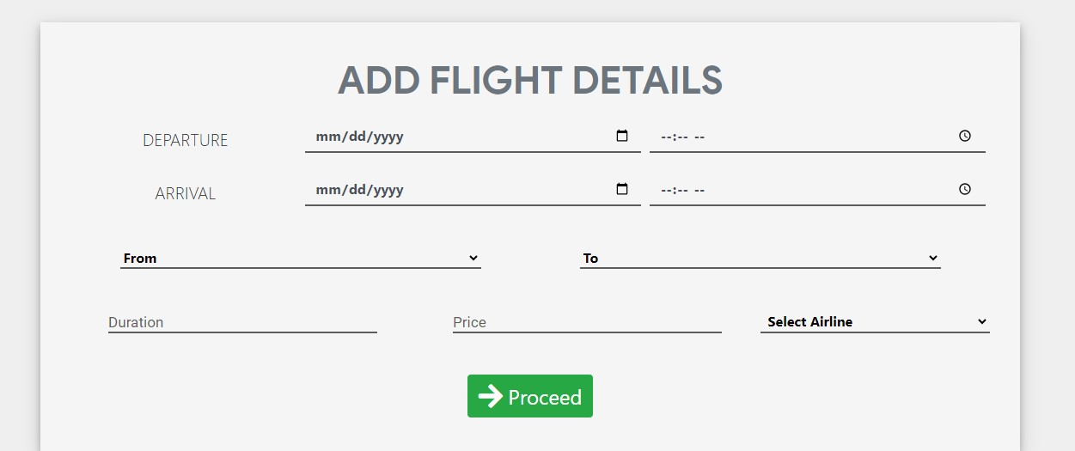
Isertion By Admin

Slide 8
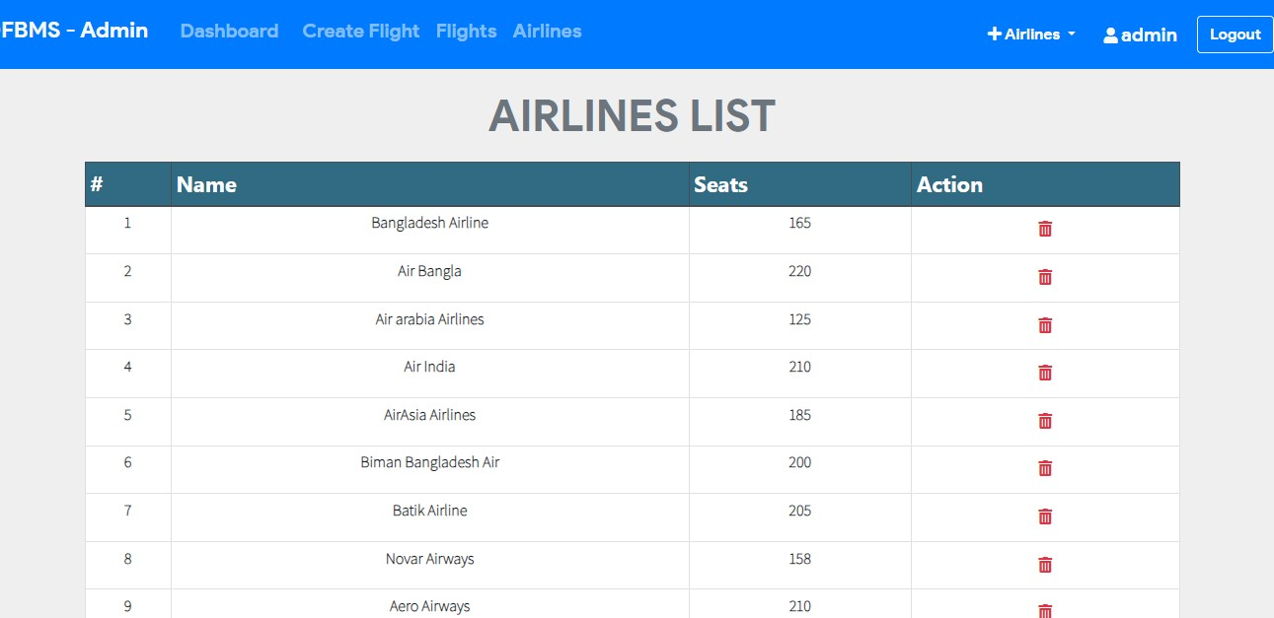
Update by Admin

